Slide 1
CASP REVIEW AND RECOMMENDATIONS
Lawrence D. Stone
Metron Inc., 11911 Freedom Dr., Suite 800
Reston VA 20190 (703) 787 8700
stone@metsci.com

Slide 2
Outline
Summary Recommendation
Review of Existing System
  (Original) CASP 1.0
  CASP 1.x
    Improvements
    Limitations and Problems
Recommendation: New System
  Goals
  Philosophy
  Features

Slide 3
Summary and Recommendation
CASP is now almost 30 years old
  One major update (CASP 1.X) in 1985
  At initial deployment CASP was innovative and highly advanced
In those 30 years there have been major advances in
  Computers
  Search planning techniques
  Environmental information
  Sensor modeling
Time has come to design and develop a new system
  Starting from scratch
  Using lessons learned from existing system

Slide 4
Orignial CASP 1.0
Fielded in 1974 on CDC 3300 Mainframe in DC
Monte Carlo Design
  Batch mode, up to 44,000 replications
  Each replication contained latitude, longitude, and weight
Scenario Generation
  Used weighted scenarios and drift modeling to produce probability maps of object (single type) location
  Initial distress scenarios limited to
    Position: Bivariate normal with offset (annular wedge)
    Trackline: Uniform along track, normal across
    Area: Uniform over region bounded by polygon

Slide 5
Original CASP 1.0
No natural or correct way to combine position, track, area scenario types
Motion Updating - used gridded wind and current data
  Each grid cell contained bivariate normal distribution for wind/current
  Independent draw for each replication and time increment
  Current plus leeway produced drift applied to replication
Search Recommendations
  List of top probability cells – in order of decreasing probability
  Optimal allocation of search effort to cells
    Often not an operationally feasible search plan
    Plan had to be approximated by user

Slide 6
Original CASP 1.0
Updating for Search – replications were motion updated to mid-search time
  Rectangle (REC)
    Computes P = probability of detection in rectangle
    Multiplies weights of replications in rectangle by 1 – P
  PATH
    Evaluates P = probability of detection for searches consisting of a sequence of straight line paths
    Multiplies weights of replications in effective area of search by
    1 – P
    Later version used Koopman’s inverse cube lateral range curve

Slide 7
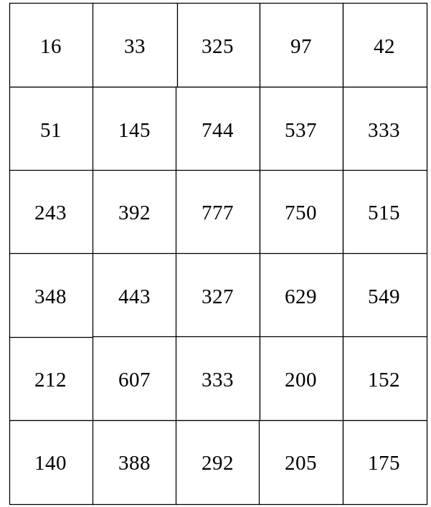
Original CASP 1.0
Probability Maps
  Grid imposed on ocean
  Weights of reps summed in each cell
  Normalized to probabilities x 10,000
CASP Probability Map

Slide 8
CASP 1.X
Existing System is CASP 1.X
  Resides on computers at OSC in Kearneysville, WV
  Accessed remotely from computer workstations
  Uses GIS interface called Command and Control Personal Computer (C2PC)
    Grafted on top of original CASP command line interface
    Requests and actions generated through C2PC interface are translated into commands
    Runs in batch mode

Slide 9
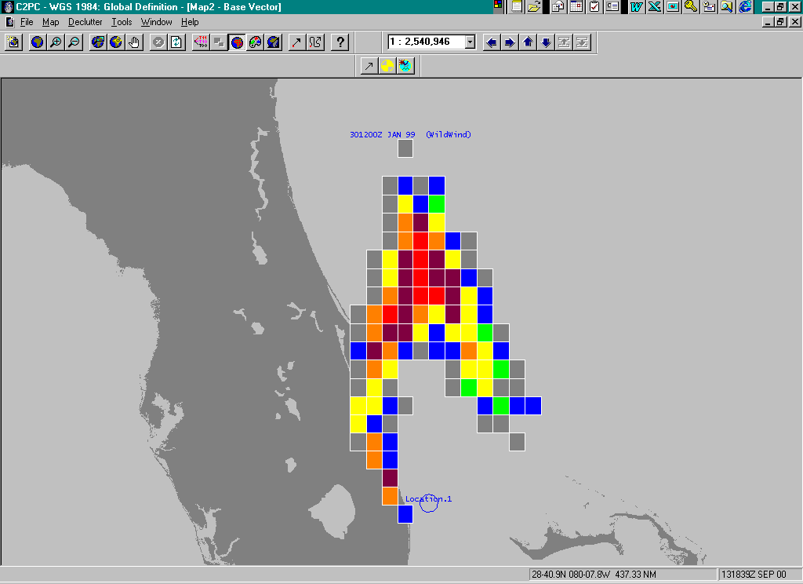
CASP 1.X
Probability maps and search plans are displayed in color
Superimposed on charts or maps

Slide 10
CASP 1.X Improvements
Additional information included with replications
  Time, object type, scenario, time of last env. analysis
Open ocean environmental products more extensive and detailed
Drift updates use consistent 1-hour increment and 100% correlation over time
Multiple object types can be represented
  Each type can have its own drift and detectability characteristics
Multiple rectangle plans produce near-optimal, feasible recommendations for multiple SRU searches

Slide 11
CASP 1.X Limitations and Problems
Position scenario generator uses only “circular normal” distribution
  Incorrect implementation of circular normal distribution over concentrates probability near center of distribution
  Spherical geometry replaced with flat earth
Search still evaluated at mid-search time
  Doesn’t account for target or searcher motion during search
  Results in inaccurate search updates and probability maps in high drift areas such as Florida Straits or Gulf Stream

Slide 12
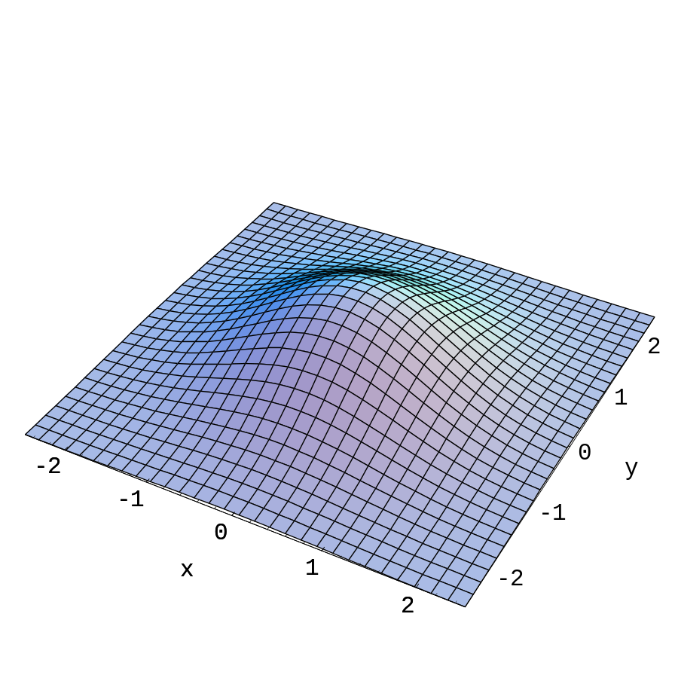
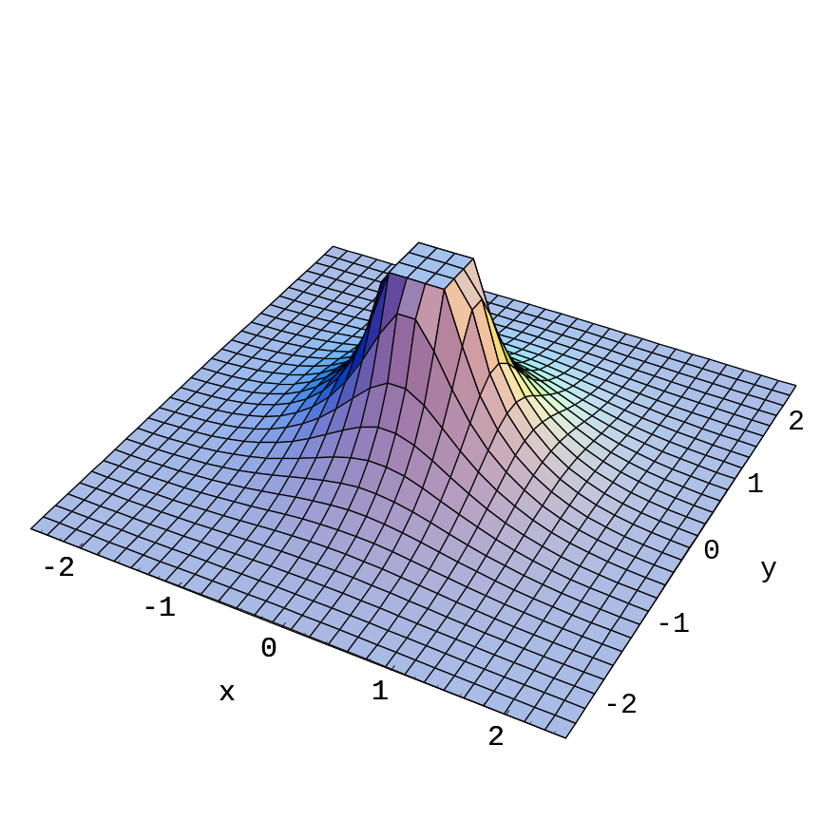
Densities for Circular Normal and Rotated Normal
Circular Normal
Rotated Normal

Slide 13
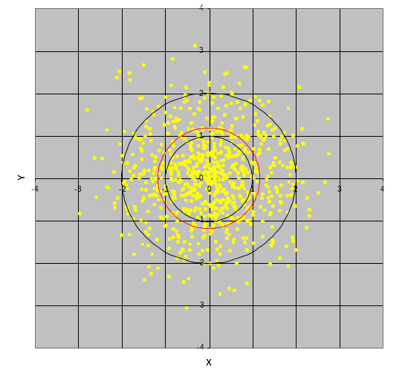
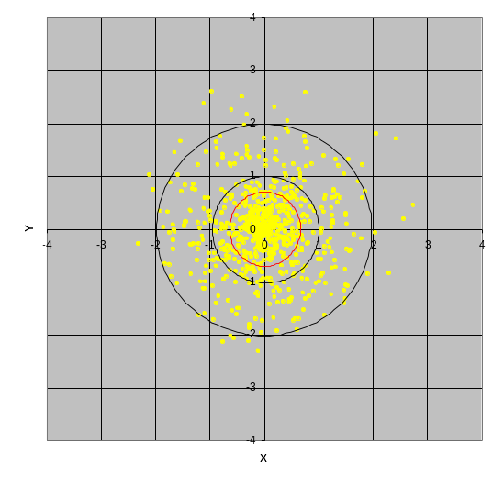
Simulation of BVN and
Rotated Normal Densities
Circular Bivariate Normal (Correct)
Rotated Normal (Incorrect)
2-σ
1-σ
CPE
The rotated normal is over concentrated near the center.

Slide 14
CASP 1.X Limitations and Problems
Position scenario generator uses only “circular normal” distribution
  Incorrect implementation of circular normal distribution over concentrates probability near center of distribution
  Spherical geometry replaced with flat earth
Search still evaluated at mid-search time
  Doesn’t account for target or searcher motion during search
  Results in inaccurate search updates and probability maps in high drift areas such as Florida Straits or Gulf Stream

Slide 15
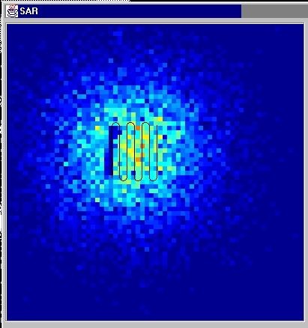
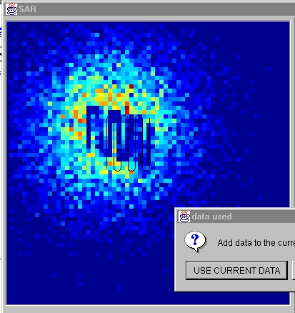
Effect of Target Motion on Search

Slide 16
CASP 1.X Limitations and Problems
Can not produce optimal plans for multiple search object types
  User has to choose a single type
Search Optimizations are static – do not account future object motion or change of state
  Change of state capability crucial for survivor searches
User interface does not guide user through search planning process

Slide 17
CASP 1.X Limitations and Problems
Scenario generation capability is limited
  Does not cover some natural ones such as a fishing boat leaving port, going to fishing areas, and returning to port
Does not work well near shore because available environmental data products do not have needed spatial and temporal resolution
Other problems described in
  Review and Recommendations for CASP, Metron Report to USCG OSC, 10 February 2003.

Slide 18
Missing F/V Scenario Type
Fishing Area A
Probable Error of Turn Point Position
Home Port
Fishing Area B

Slide 19
CASP 1.X Limitations and Problems
Scenario generation capability is limited
  Does not cover some natural ones such as a fishing boat leaving port, going to fishing areas, and returning to port
Does not work well near shore because available environmental data products do not have needed spatial and temporal resolution
Other problems described in
  Review and Recommendations for CASP, Metron Report to USCG OSC, 10 February 2003.

Slide 20
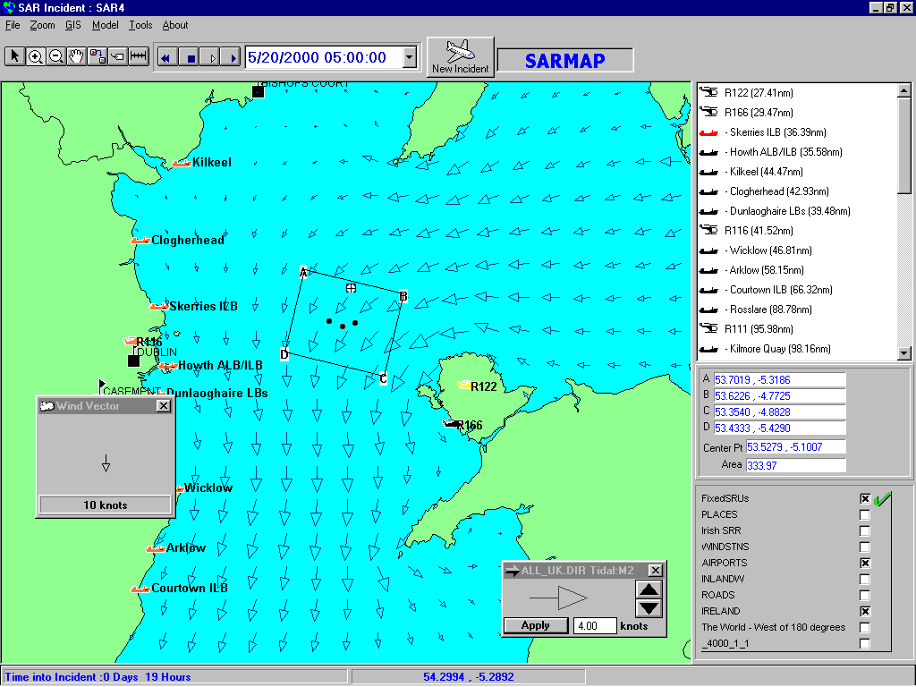
Detailed Near-Shore Currents

Slide 21
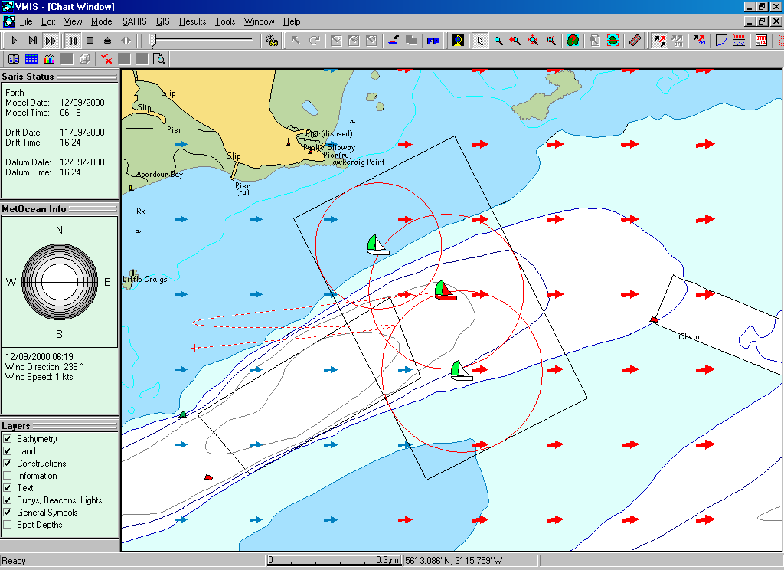
Effect of Time-Varying Currents

Slide 22
Recommendations for New System
Goals
Provide a new system with the following characteristics
  A single system which replaces CASP and AMS (JAWS)
  Easy and natural to use
  Produces more accurate probability maps
    Better scenario modeling
    More detailed/accurate environmental and drift models
    Better sensor and search effectiveness modeling
    Better search planning recommendations
      Moving objects
      Multiple state searches – optimal survivor search
  More easily maintained and operated by the USCG

Slide 23
Recommendations for New System
Philosophy
Logical structure and features of system should follow the structure and nature of search planning process (next slide)
  System should guide user through process
  Could provide wizard to suggest next steps
  System must be highly responsive to on-screen manipulations of objects such as search areas, search patterns, etc.
Implications for development team
  Multidisciplinary
    Computer scientists, systems designers and developers, GIS experts
    Operational personnel familiar with SAR planning
    Search theory experts
    Oceanographers and environmental data providers

Slide 24
Recommendations for New System
Search Planning Process
Gather data and information
Produce search scenarios from this information
Identify search resources and obtain environmental predictions
Produce and revise search plans
Implement search plans
Update object location distributions for actual search and environmental conditions
Update scenarios for new information (if necessary)
Go back to 3.

Slide 25
Recommendations for New System
Features (1)
Improved Monte Carlo Design
  More flexible and realistic scenario modeling
  Include past history with each replication
  Add survivor lifetime to replications
  Allow automatic resampling when necessary
Planning wizard for guiding user through planning process
Expanded scenario capability
  Handle natural scenarios such as: Start in port, go to fishing areas, return to port
  Allow objects to change state and encounter hazards
  Allow for multiple objects adrift simultaneously (Mass Rescue Ops)

Slide 26
Recommendations for New System
Features (2)
4. Improved drift modeling
  Higher resolution near shore
  Account for space and time correlation
  Implement improved USCG R&D Center leeway model
  Use better interpolation techniques such as inverse time
  Correctly handle landed and adrift objects
  Incorporate information from real-time environmental measurements

Slide 27
Recommendations for New System
Features (3)
5. A single system that performs well in open ocean and near shore environments with smooth transitions
6. Improved sensor and detection modeling
  Use lateral range functions
  Account for multiple sensors on single platform
  Account for motion of object and searcher during search
Search plan recommendations
  Multiple object types and survivor lifetime searches
  Sequence of near optimal searches for moving objects

Slide 28
Recommendations for New System
Features (4)
Reporting and documentation
  Automatic reporting and documentation of searches
  Automatic interface to USCG SAR records database
Implementation
  C⁺⁺, FORTRAN, or Java all possible – USCG choice
  Central or distributed system – operational choice by USCG.
    Good system can be developed for either implementation
    Users in operations centers likely to need local workstation to perform search planning and other operations in high workload situations
Training –
  Coast Guard must continue to support training of CASP users
  Training should be easier with one system in place of two

Slide 29
Backup Slides

Slide 30
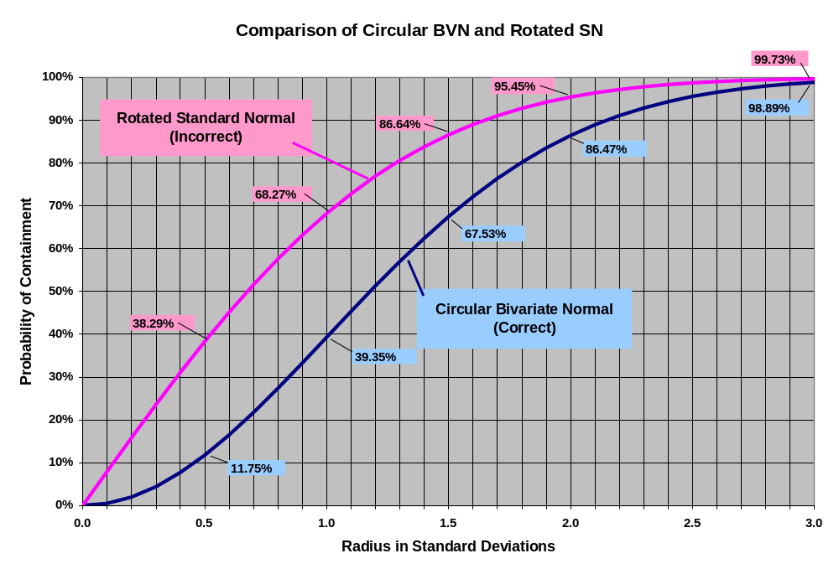
Comparison of BVN and Rotated Normal

Slide 31
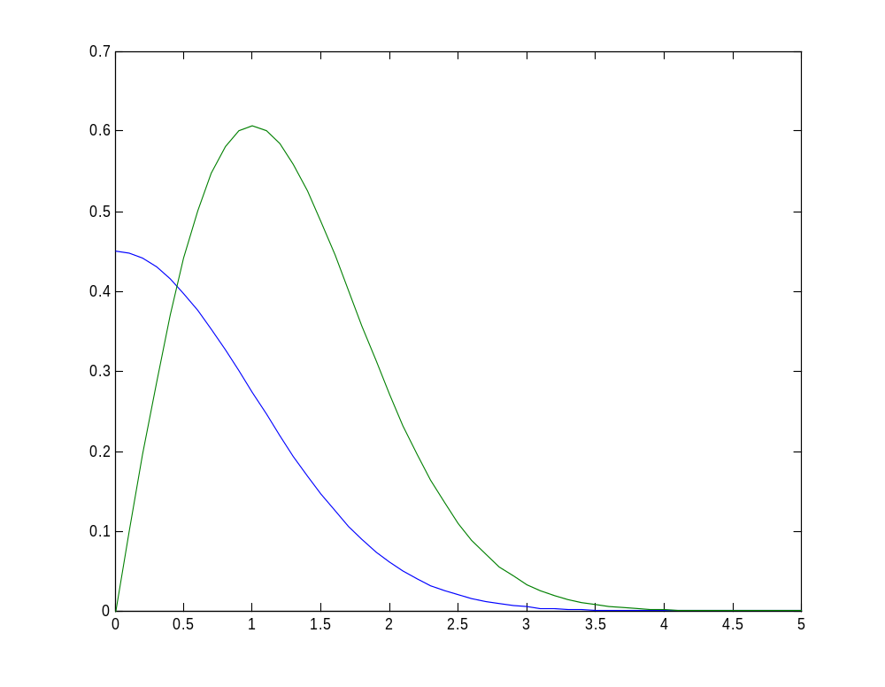
Rotated 1-D vs. Circular Normal
Circular Bivariate Normal (Correct)
Probability Density
Rotated 1-D Normal (Incorrect)
Distance from Origin in Units of Standard Deviation

